Slide 1


RUNGTA
INTERNATIONAL SKILLS
UNIVERSITY
Rungta International Skills University
B.Tech 1st Sem IBM
PS No. 5 - Electricity Bill Calculator
Submitted By
Submitted To
Anubhav chand
Mr. Priyanshu
RU - 26 - 01803
IBM SME

Slide 2
Introduction
•
Project Title: Electricity Bill Calculator (PS No. 5).
•
Purpose: Calculate accurate electricity bills from units consumed.
•
Slab System: Applies progressive tier rates based on consumption.
•
Error Handling: Validates user input against negative or text values.
•
Formatted Receipt: Displays Energy Charge, Fixed Charge, Tax, and Total Bill.

Slide 3
Project Description & Problem Statement
Consumption Slab | Rate / Charge
First 100 units (0–100) | Rs. 3 / unit
Next 100 units (101–200) | Rs. 5 / unit
Above 200 units (>200) | Rs. 8 / unit
Fixed Charge | Rs. 50
Tax (on Energy + Fixed) | 5%
Problem Statement
Write a program that calculates an electricity bill from the units consumed using slab-wise rates, a fixed charge and tax, and prints a formatted bill.
Concepts: Conditions, Operators, Functions

Slide 4
Technology & Tools Used
Python 3
Conditions
Functions
VS Code & GitHub
Core programming language.
if-elif-else slab logic.
Modular bill calculation blocks.
Code execution and repository.

Slide 5
Working of the Project
1. Input
2. Validation
3. Slab Calculation
4. Print Bill
Take consumer name and units.
Check non-negative numeric input.
Run calculate_energy_charge().
Run generate_bill() with 5% tax.
Total Bill = Energy Charge + Fixed Charge (Rs. 50.00) + 5% Tax

Slide 6

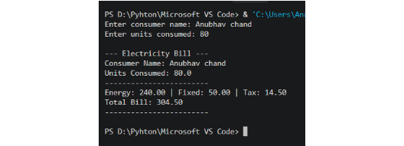
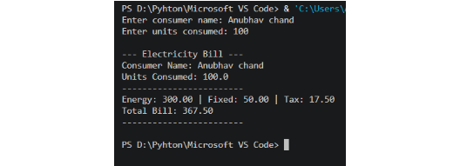
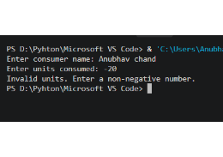
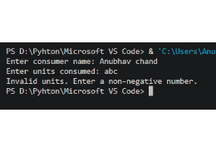
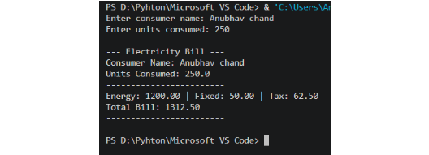
Project Screenshots
Test Case 1: Normal Input (Units: 80)
Test Case 2: Boundary Input (Units: 100)
Test Case 3: Invalid Input (-20 & abc)
Test Case 4: Valid Scenario (Units: 250)

Slide 7
Thank You

